Slide 1
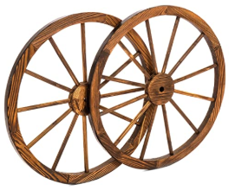
UiAutoWagon
Web Ui Automation
– Is it not painful?
– Because of Xpath (or other locators) identification!
Lets skip writing xpath and will reduce a major effort of Web UI automation.
Let UiAutoWagon Smart Robot do the job for us
Idea By,
Manjunath KS
Bangalore
Manjunath.ks@globallogic.com
+91-9611884272

Slide 2
How Automation test engineers currently work
Indentify locator’s
expressions
Inspect the element
Maintenance of locators
Utilize locators into
test scripts
to perform actions
Store into the POM/ Object repository
Selenium Web Driver
Why Automation test engineer need UiAutoWagon
Simple, it avoids all the burden of preparation of locators, usability and maintainability of locators

Slide 3
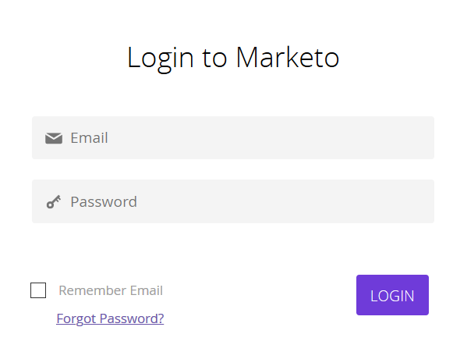


UiAutoWagon Overview
A Java
Robotic
Intelligent Library
UiAutoWagon
UiAutoWagon.
sendKeys(“Email”, “Example@email.com”)
UiAutoWagen is going to be a smart semi supervised intelligent library.
Helps to auto detect the locator of given UI component by itself.
Performs required actions on auto detected elements.
Can be developed to support different like java, python, C# etc

Slide 4
Business Model/ Market Opportunity
Current Web Ui Automation | UiAutoWagon Utilization
Selenium WebDriver – Xpath preparation is not supported | UiAutoWagon gives solution to avoid preparing Xpath completely.
There are tools to fasten the xpath preparation – Xpath Helper, ChroPath etc. | UiAutoWagon avoids using locators in selenium automation scripts
There are few top leading tools ex- Robot framework and etc | UiAutoWagon will be the first tool to avoid xpath.
It takes 7-8 mins to find stable xpath of each locator (developer tool) | Time required - Zero

